Slide 1
DIGITAL PORTFOLIO
STUDENT NAME : SARANRAJ S
REGISTER NO : 31924U18027
DEPARTMENT : BSc (Computer Science)
EMAIL ID : saranrajsounder.sm@gmail.Com
COLLEGE : Mazharul Uloom College Ambur
UNIVERSITY : Thiruvalluvar University

Slide 2
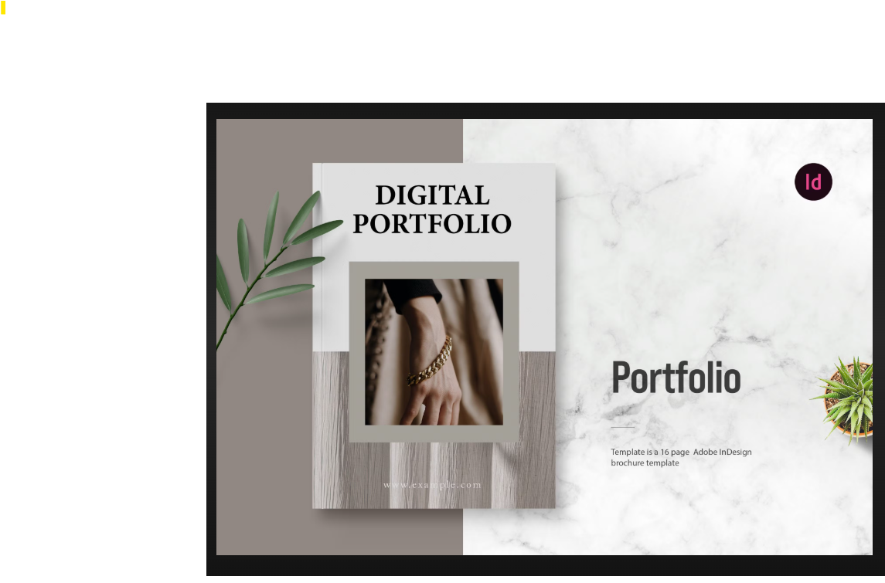
PROJECT TITLE

Slide 3

agenda
PROJECT STATEMENT
PROJECT OVERVIEW
END USERS
TOOLS AND TECHNOLOGIES
PORTFOLIO DESIGN AND LAYOUT
FEATURES AND SCREENSHOT
GITUP LINK
CONCLUSION

Slide 4
PROJECT STATEMENT
Traditional resumes are static and fail to showcase creativity and technical skills effectively. In today’s digital era, employers prefer interactive and accessible online profiles. A digital portfolio provides a responsive platform to highlight skills, achievements, and certifications while enhancing personal branding and career opportunities

Slide 5
PROJECT OVERVIEW
A responsive personal portfolio website showcasing key information.
Built using HTML, CSS, and JavaScript.
Includes Home/About Me, Certificates, Skills, and Contact sections.
Provides a platform for personal branding.
Ensures cross-device compatibility for better accessibility.
Helps build a strong digital identity for future growth.

Slide 6

WHO ARE THE END USER
🎓 Students/Peers – to view my academic background, skills, and certifications for collaboration or learning.
💼 Employers/Recruiters – to assess my skills, achievements, and professional potential during hiring.
👨‍🏫 Teachers/Mentors – to evaluate my academic growth, projects, and certifications.
🤝 Collaborators/Team Members – to connect for projects, internships, or research work.

Slide 7
TOOLS AND TECHNIQUES
💻 HTML – to create the structure of the website. 🎨 CSS – to design the style and layout. ⚡ JavaScript – to add basic interactivity. 📱 Responsive Design – to make it work on all devices. 🧩 VS Code – as the code editor. 🌐 Browser – to test and view the website

Slide 8
PORTFOLIO DESIGN AND LAYOUT
Header – Contains name and navigation menu.
Home/About Me – Short introduction with profile photo.
Certificates – Shows certifications in list or grid format.
Skills – Displays technical and soft skills with lists or progress bars.
Contact – Includes form, email, and social media links.
Footer – Contains copyright information and quick links.
Responsive Layout – Works smoothly on desktop, tablet, and mobile devices

Slide 9
FEATURES AND FUNCTIONALITY
📱 Responsive Design
🧭 User-Friendly Navigation
👤 About Me Section
📜 Certificates Section
🛠️ Skills Section
✉️ Contact Section
⚡ Interactive Elements
🎨 Professional Layout

Slide 10
RESULTS AND SCREENSHOT
HELLO ,I AM GOPIKA D LEARNER EXPLORING WEB DEVELOPMENT AND TECHNOLOGY EXPLORING I ENJOY ATTENDING THE CONFERENCE AND BUILDING CREATIVE PROJECT
CERTIFICATES
A NATIONAL CONFERENCE OF ADD ON COURSE IN EVERY DAY LIFE AND RECEIVED A CERTIFICATE
A NATIONAL CONFERENCE ON ARTIFICIAL INTELLIGENCE(AI)
OVERVIEW OF ENGLISH COMMUNICATION
WEB DEVELOPMENT-IBM SKILLBUILD
CLOUD COMPUTING-IBM SKILLBUILD

Slide 11
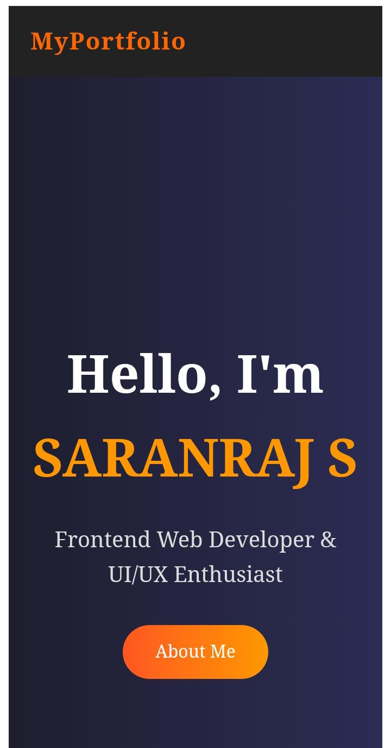
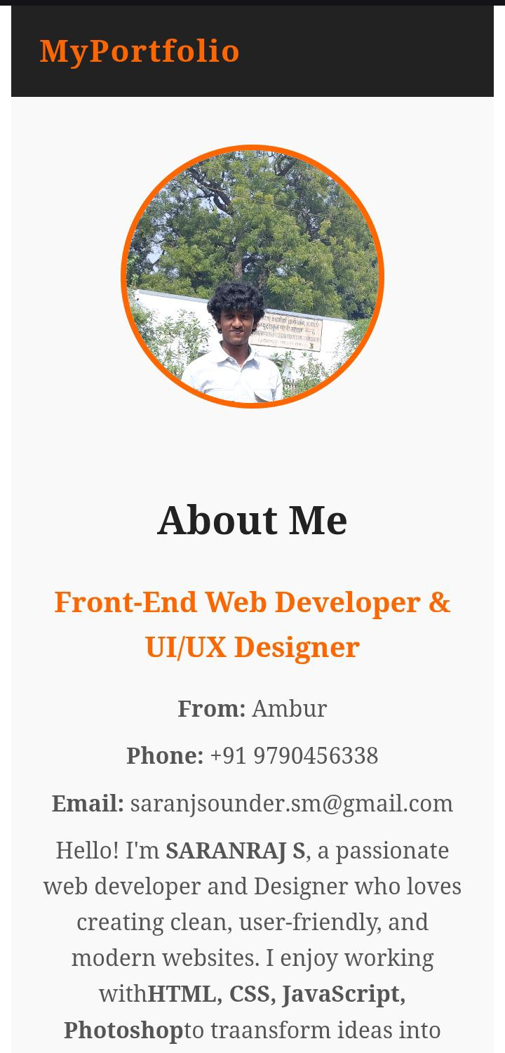
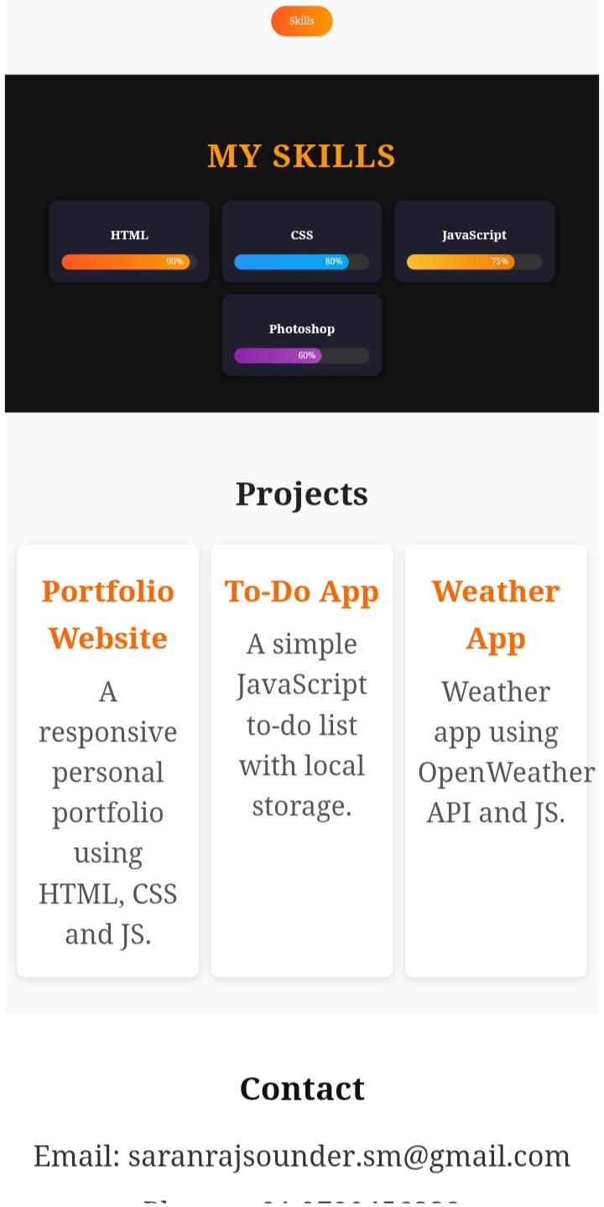

SCREEN SHOTS OF MY PORTFOLIO
------------------------------------------------------------------------------------------------------------------

Slide 12
GITHUB AND portfolio LINK
/
This is my profile and my digital portfolio link.
https://github.com/saranrajsoundersm-ship-it/portfolio.git
MY GITHUB URL
https://saranrajsoundersm-ship-it.github.io/saran-s-portfolio/

Slide 13
conclusion
🎯 The Digital Portfolio project has been successfully developed to showcase my skills, certifications, and achievements in a professional manner. 💻 Built using HTML, CSS, and JavaScript, it ensures a clean design and smooth functionality. 📱 The website is fully responsive, working across desktop, tablet, and mobile devices, while 🧭 providing user-friendly navigation for visitors. 🚀 This project not only strengthens my digital identity but also creates better academic and career opportunities. 🌟 Overall, it reflects my web development knowledge and creativity, making it an effective platform for personal branding.

Slide 14


